Slide 1
BinaxNow COVID 19 Antigen Test:
Who is Eligible for Testing?
Any student or staff member with COVID-19 symptoms may be eligible for antigen testing
The benefit to antigen testing is that SLPS nurses can test on site with results returned in 15 minutes
Staff currently present at schools can get tested at their site, but should email PositiveTest@slps.org first to coordinate an appointment
Students currently present at schools can get tested at their site with parent consent
Staff calling in and not yet at school may have the opportunity to get tested at their building site – email PositiveTest@slps.org for an appointment
Students calling in and not yet at school should be given other alternatives for testing/return to school
Staff or students that test negative whose symptoms can be attributed to a non-COVID, non-currently-contagious condition (based on the individual’s history and/or the nurse’s professional assessment) have the opportunity to stay at school/work

Slide 2
BinaxNow COVID 19 Antigen Test:
COVID 19 Symptoms
Fever (100.4 or above)
Chills
Cough
Shortness of breath or difficulty breathing
Fatigue
Muscle or body aches
Headache
New loss of taste or smell
Sore throat
Congestion or runny nose
Nausea or vomiting
Diarrhea

Slide 3
Students at School with Symptoms
All students at antigen site schools who are already at school with symptoms are eligible for testing.
First, the Principal’s designee should remove the student and take him/her to the school nurse for an assessment.
If the nurse assesses that the student is exhibiting any of the potential COVID-19 symptoms, testing can occur. The nurse will verify and/or obtain consent from the parent for testing.
  If there is a consent on file, or the parent is able to complete contemporaneous electronic consent, the test can proceed.
  Otherwise, the parent will need to come to school to sign a consent before the test can proceed.
Once parent consent is obtained, the nurse, student and Principal’s designee should present to the recovery/isolation room for testing.
Report positive results to PositiveTest@slps.org. Include contact information for the positive individual, for next steps in COVID response, contact tracing, and quarantine assessment.

Slide 4
Students at School with Symptoms
For a negative test result, students may remain at school so long as:
  No known exposure to COVID-19 positive person (must always complete a 14-day quarantine – email PositiveTest@slps.org to get a contact tracer assigned)
  Fever free (must be fever free for 24 hours without medicine to return to school)
  Symptom is not sudden loss of taste or smell
  Symptoms can be attributed to a non-COVID, non-currently-contagious condition
  This assessment should be made based on the student’s history and/or the nurse’s professional assessment
  Examples: student with known history of allergies, asthma, sinus infections, etc.
  Students who are potentially contagious with a different illness (e.g. with symptoms of sore throat or cough that cannot be attributed to a non-currently-contagious condition) should be sent home until symptoms are improving. The goal is to keep students at school once COVID is ruled out, but only if the symptoms can be attributed to a non-currently-contagious condition.

Slide 5
Students NOT YET AT SCHOOL
Students calling in to school with symptoms:
  Ask whether the student has had a known exposure to someone who has tested positive for COVID-19. If yes, immediately email PositiveTest@slps.org for contact tracing and quarantine assessment.
  If no known exposure, follow the Updated Student Symptom Decision Tree with relevant written follow-up (see letters in Referral Guide).
  Students who are not currently at school who call in with symptoms should be given other alternatives pursuant to the Updated Student Symptom Decision Tree, rather than being brought into school for antigen testing.

Slide 6
Staff at School/Work with Symptoms
All staff members who are already at school with symptoms are eligible for testing.
First, the staff member should email PositiveTest@slps.org and the building principal, specifying his/her symptoms and the need for an antigen test.
  The principal should assist in providing class coverage if necessary.
  Principal should confirm whether the staff member has had a known exposure to someone COVID positive. If yes, this should immediately be reported to PositiveTest@slps.org for contact tracing and quarantine assessment.
  The staff member should bring his/her things needed to leave for the day in the event of a positive test or assessment that the staff member cannot remain on site due to nature of symptoms.
The assigned Contact Tracer will contact the nurse to schedule testing. The staff member should present to the school nurse for an assessment and testing.
The nurse and staff member should present to the recovery/isolation room for testing.
For a positive test result, immediately email PositiveTest@slps.org for next steps in COVID response, contact tracing, and quarantine assessment.

Slide 7
Staff at School/Work with Symptoms
For a negative test result, staff members may remain at school/work so long as:
  No known exposure to COVID-19 positive person (must always complete a 14-day quarantine – email PositiveTest@slps.org to get a contact tracer assigned)
  Fever free (must be fever free for 24 hours without medicine to return to school/work)
  Symptom is not sudden loss of taste or smell
  Symptoms can be attributed to a non-COVID, non-currently-contagious condition
  This assessment should be made based on the staff member’s stated history and/or the nurse’s professional assessment
  Examples: staff member with known history of allergies, asthma, sinus infections, migraines, etc.
  Nurses should defer to staff members regarding their history of conditions

Slide 8
Staff NOT YET AT SCHOOL
Staff calling in to school with symptoms:
  Staff member should be directed to email PositiveTest@slps.org for explanation of symptoms and to schedule a test
  The Contact Tracer assigned will gather relevant details and instruct the staff member not to come in until testing is secured
  The Contact Tracer will contact the nurse at their assigned school to coordinate a test
  If the staff member has substantial symptoms (sudden loss of taste or smell, bad cough, fever), the Contact Tracer will suggest testing outside of school
The staff member will be routed a site for antigen testing, with his/her consent.
  Next steps will be provided by the COVID Response Team, nursing/testing staff, and/or Contact Tracing Team
  If the person does not consent to COVID testing, they must stay home until symptoms have resolved/improved and fever-free for 24 hours without medicine
  Must use sick time until released to return to work

Slide 9
Contact Tracing Team
Jayme Major, Assistant General Counsel, 314-437-1759
Karlla Dozier, Director of Employee Relations, 314-349-5162
Jacqueline Russell, Principal, special assignment contact tracing, 314-879-4276
Annamaria Lu, Paralegal, 314-345-4562
Briana Beacham, Intern

Slide 10
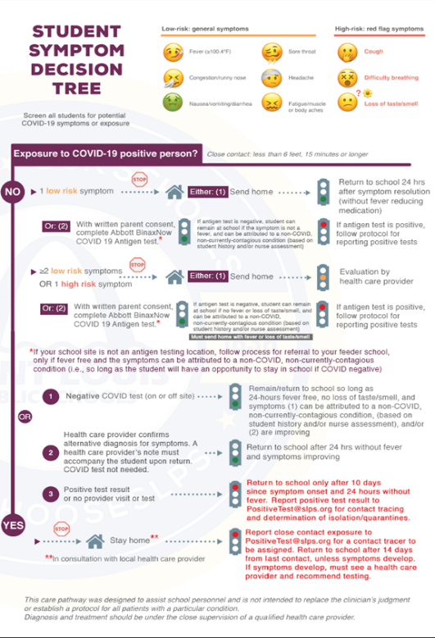

Slide 11
Questions?

